Slide 1
BlueCat
Interactive Productivity Manager Team 2
Rachel Gan, Young Woong Jun, Sigrid Marita Kvamme, Jin Yeong Kim, Seung Woo Jo
Notes:
Good afternoon, I’m jinyeong kim and I’m the first speaker of team 2’s presentation

Slide 2
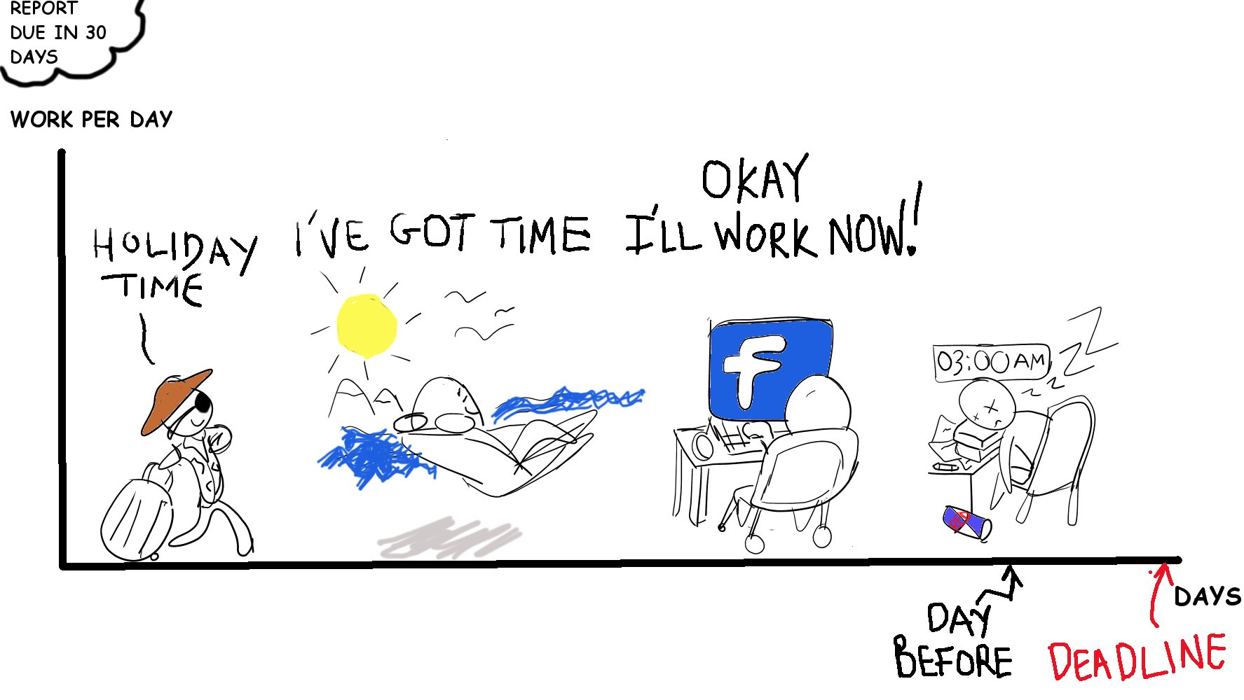
Project Idea Interactive Productivity Manager
Target Audience
Students or workers who have problems meeting deadlines
Procrastinators and people who get distracted easily
Goal
Prevent users from procrastinating and help them to increase their productivity while staying happy
Notes:
Our project Idea stays in the similar shape as we have presented earlier
Our App targets people who have trouble meeting the deadlines of theirs tasks
So, we aim to help those people to increase their productivity with three features
We have divided our team into 3 small groups and each group will present details of each feature.

Slide 3
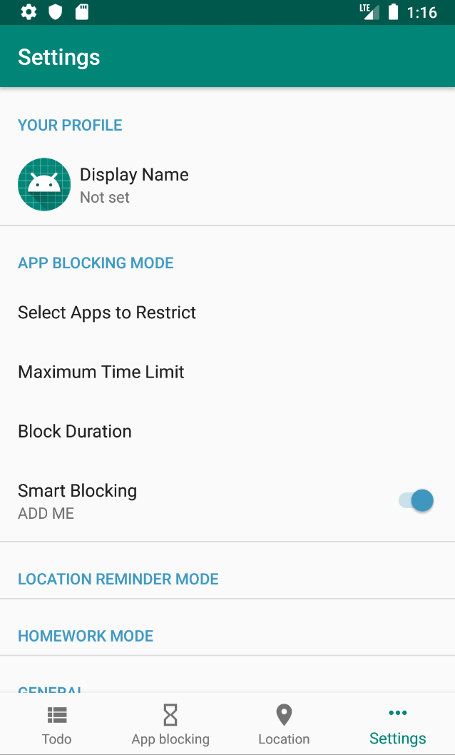
Quick Architecture
Three separate features
To-do List & HW Mode / Location-Reminder / App-Blocking
Common settings page
Controls settings for each function at one page
Local Database using Room
Separate database for each function
Foreground service
App-blocking features
Location-reminder features
Notes:
Before we start with the details, I would like to briefly explain the architecture of our app and project schedule
First, the architecture
Like I mentioned, we have separate features and each feature has own fragment and a user can navigate through them with navigation bar
We also share a single settings page which a user can control all the settings related to each feature
For the database, we use local database using Room, It’ basically, abstraction layer over SQLite.
Since we don’t store a lot data, we use the local database
and we have some foreground services for app-blocking and location-reminder features

Slide 4
Project Schedule
Spreadsheet ( Project Plan , Check up on the progress ) : https://docs.google.com/spreadsheets/d/1QyvoBminOBTyXSOlePHeygPNn8a5bCXSTumpKnIcDBE/edit#gid=1533464390
Git Issues ( Easy Daily Management ) : https://github.com/ywj7373/MC-group2/issues
What has been done
Getting familiar with Android development with Kotlin
Implement basic functionality of the project (details later)
What will be done
Implement the features that have not been completed yet (details later)
Notes:
###Show them the excel sheet & github issues(project plan) briefly###
We are using both spreadsheet and github issues
We have converted our project plan into github issues and milestones for easy management on daily basis
and we check on our progress using the project plan when we have regular meeting
Until now, we have got a bit more familiar with Android development and have implemented basic functionality of the project
for the rest of the period, we’ll finish implementing the features that have not been completed the details will be on following slides

Slide 5
Project Schedule - Deviations
To-do List & Homework mode
Have not made basic version of motion detector
App blocking
Step count feature for unblocking not fulfilled (not a core feature)
Not implemented information notifications
Location-Reminder
Notification alert not yet implemented
Not implemented gamification
Notes:
Also we have faced little bit of deviation from the original plan, nothing critical, but just could not complete the tasks we have scheduled to do.

Slide 6
To-Do List & HW Feature

Slide 7
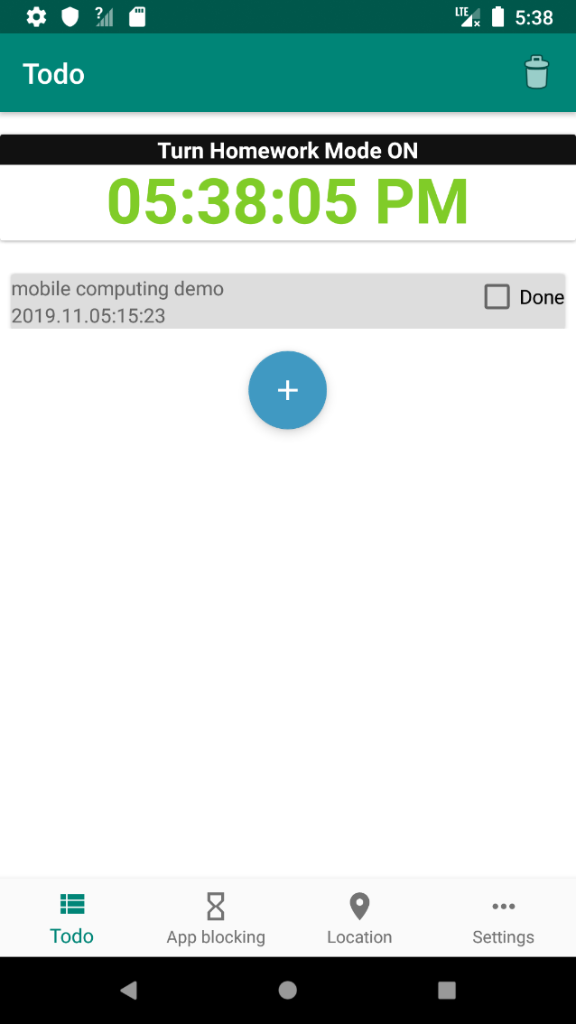
To-Do List & Homework Mode DEMO
Common To-Do List functions
Mark tasks done, undone
add, delete tasks
Homework Mode
Homework mode activates instant app blocking on the list of apps set in the settings page
Alarm goes off if a user does not check in before timer ends
Alarm can be turned off by making some motions ( shaking the phone 10 times or walk 30 steps around)
Notes:
So, the first feature, To-do List and Homework mode
feature two features are grouped into one feature and share the same fragment (view)

Slide 8
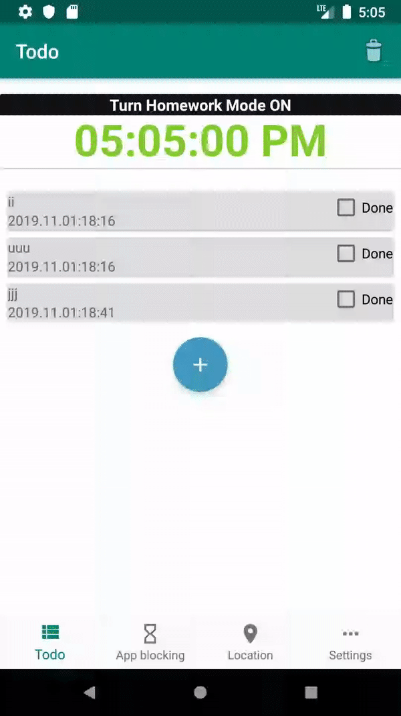
To-Do List & Homework Mode DEMO
Common To-Do List functions
Mark tasks done, undone
add, delete tasks
Homework Mode
Homework mode activates instant app blocking on the list of apps set in the settings page
Alarm goes off if a user does not check in before timer ends
Alarm can be turned off by making some motions ( shaking the phone 10 times or walk 30 steps around)
Notes:
For the To-Do List, it can add, delete tasks and mark them done or undone, That’s it. it’s a very common to-do list

Slide 9
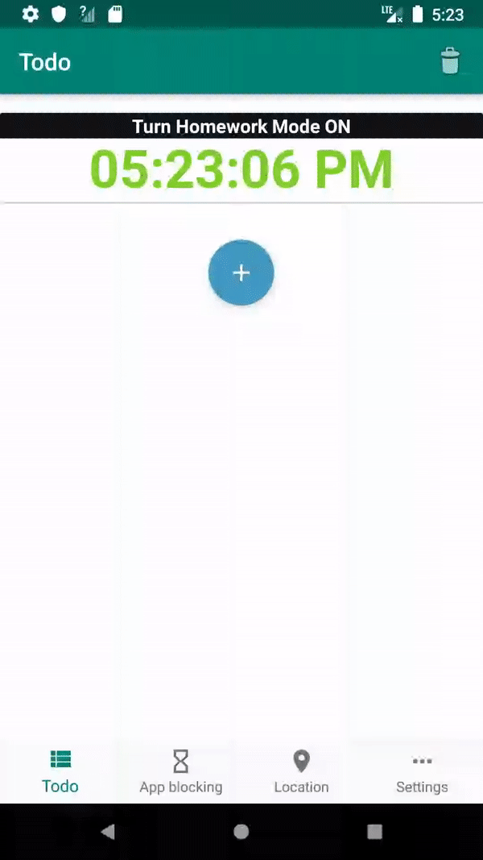
To-Do List & Homework Mode DEMO
Common To-Do List functions
Mark tasks done, undone
add, delete tasks
Homework Mode
Homework mode activates instant app blocking on the list of apps set in the settings page
Alarm goes off if a user does not check in before timer ends
Alarm can be turned off by making some motions ( shaking the phone 10 times or walk 30 steps around)
Notes:
Set the title, date, and time and done.

Slide 10
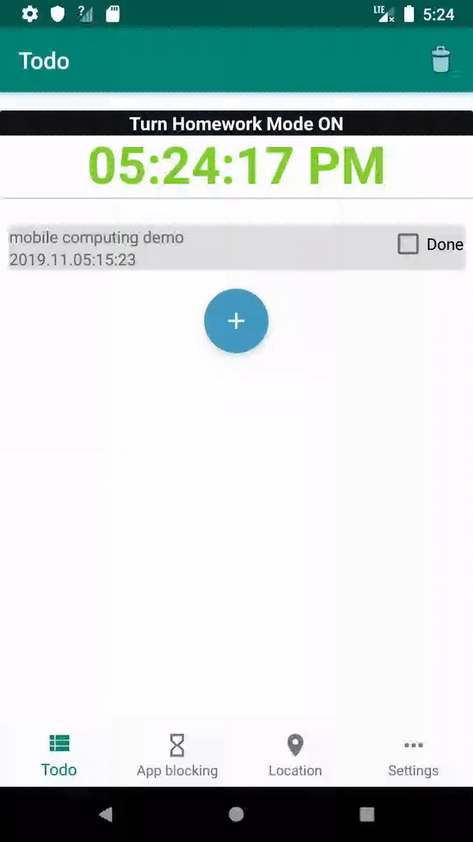
To-Do List & Homework Mode DEMO
Common To-Do List functions
Mark tasks done, undone
add, delete tasks
Homework Mode
Homework mode activates instant app blocking on the list of apps set in the settings page
Alarm goes off if a user does not check in before timer ends
Alarm can be turned off by making some motions ( shaking the phone 10 times or walk 30 steps around)
Notes:
To turn on the homework mode, a user can press the button on the upper part of the view
It’s very simple to turn on, but once it’s on, It’ not simple to turn it off, you have to type in the text that makes you somewhat guilty if you have not finished your job.
During the homework mode, you can’t use the apps on the blocking lists and alarm goes off if a user does not check in before timer ends to prevent a user from falling into sleep
This alarm can only be turned off by making some motions ( shaking or walking )

Slide 11
To-Do List & Homework Mode DEMO
Scenario
Must finish Mobile demo presentation slides by tomorrow
But, a new mobile game I’ve started playing is so fun.
So, I block the game (add it to the blocked app list) and turn on Homework Mode
I can’t play the game until I turn off HW mode
When I try to turn off HW mode even though I haven’t finished my homework, I feel guilty because of the text that I have to type in.
So, I keep working on the slides and finish them and happily play the game later :)
If I fall asleep while doing the homework, the alarm wakes me up.
Notes:
So, the use cases

Slide 12
Going forward To-Do List & Homework Mode
Things to be implemented
Stable Timer
Send Notification 5 minutes prior to timer ends (with vibration)
Make alarm go off as timer ends
Use motion data to turn off the alarm
Expected technical challenges
Keeping the timer going as the app goes to the background
Detecting user motions
Notes:
So, From now on, I have to work on keeping the timer going even though the app goes background
and also on notification and motion sensors
until now, I’ve learned basics of android programming with kotlin and about the Android MVVM pattern with Room

Slide 13
App-Blocking Feature

Slide 14






App Blocking Use Case
Without BlueCat
With BlueCat
Notes:
User has work to do but is spending too much time on Youtube
User turns on App blocking function on BlueCat
User procrastinates and continues watching Youtube videos
After 30 mins (default), the BlueCat app blocks Youtube and sends user to app blocking screen
User stops procrastinating and gets back to work
When user is finished with work or wants to take a break, can watch YouTube again.
If user continues to watch Youtube, app is blocked again after 30 mins

Slide 15
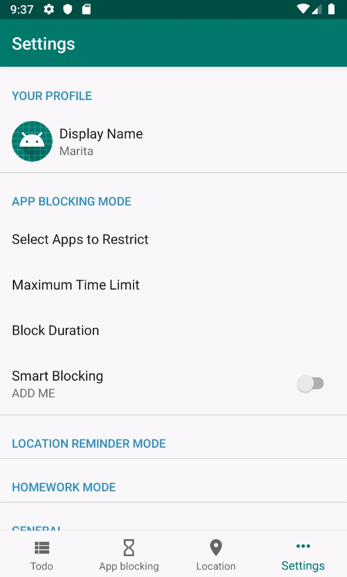
App Blocking DEMO
gif here
User chooses custom preferences
Select apps to block from app list
Choose time limit for app usage (default 30min)
Choose block duration (default 5mins)
Usage access permissions
Requests for usage access permission
App blocking
If you use a restricted app for more than the limit, it will block the app and redirect you to block countdown view
Resets usage timer if you take a break

Slide 16
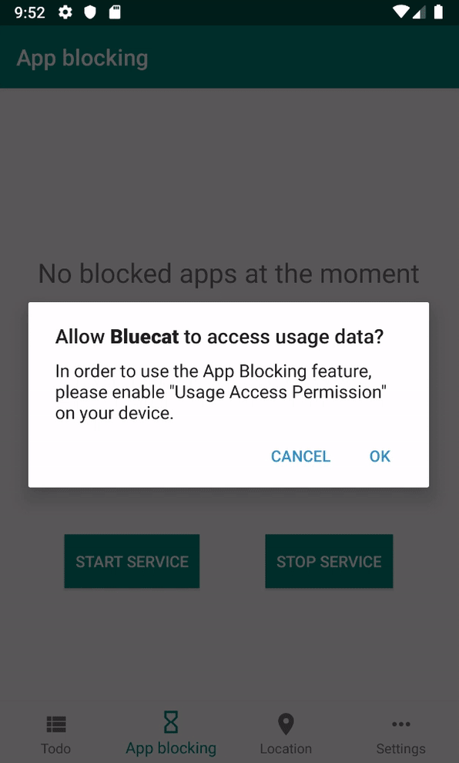
App Blocking DEMO
gif here
User chooses custom preferences
Select apps to block from app list
Choose time limit for app usage (default 10s)
Choose block duration (default 5mins)
Usage access permissions
Requests for usage access permission
App blocking
If you use a restricted app for more than the limit, it will block the app and redirect you to block countdown view
Resets usage timer if you take a break

Slide 17
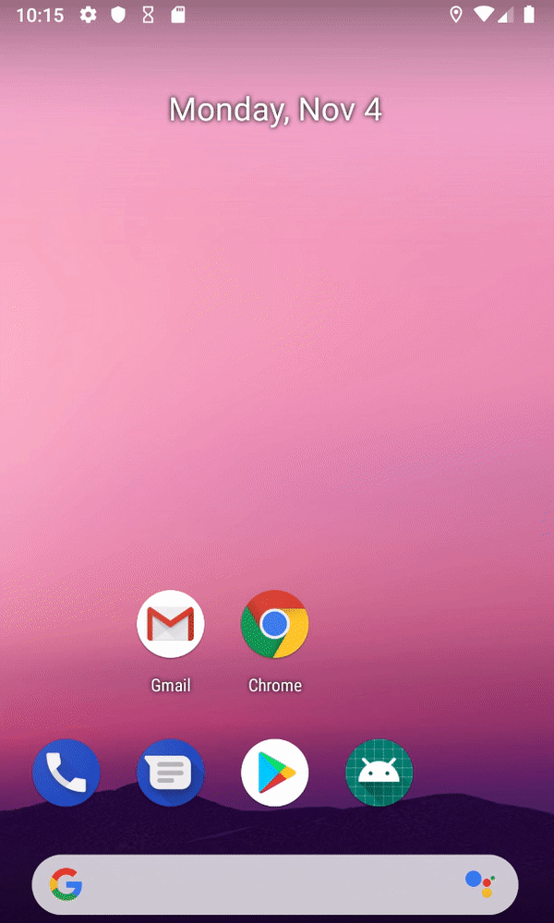
App Blocking DEMO
gif here
User chooses custom preferences
Select apps to block from app list
Choose time limit for app usage (default 10s)
Choose block duration (default 5mins)
Usage access permissions
Requests for usage access permission
App blocking
If you use a restricted app for more than the limit, it will block the app and redirect you to block countdown view
Resets usage timer if you take a break

Slide 18
App Blocking Key Technical Challenges
Challenges
Solutions
Block app based on app usage in a smart way.
Develop an algorithm based on different types of data from device to guess when user is procrastinating (yet to be developed)
Unblock the app after a set amount of time
Remove app from blocking list after internal countdown timer finishes
Blocking multiple apps (each app needs its own countdown timer)
Store a map containing the blocks for each app, display countdowns of all blocked apps
Notes:
- Be as detailed as possible.
• Clarify what were already solved and what are still needs to be addressed.
• Encouraged to have initial evaluation results (on latency, power, accuracy, etc.).

Slide 19
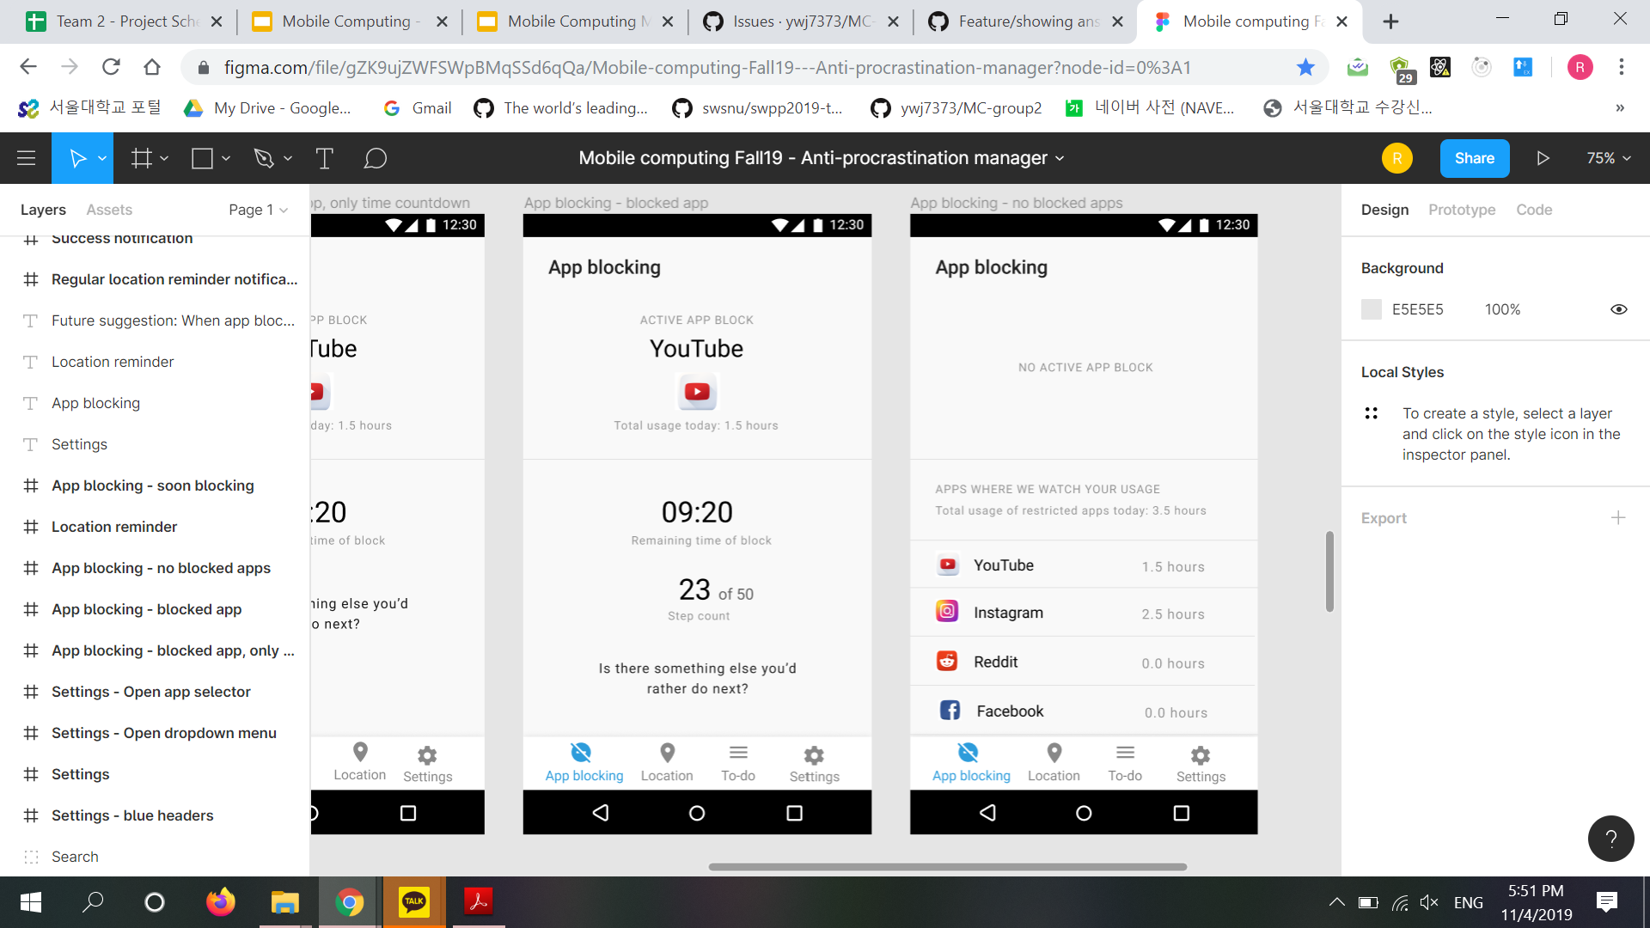
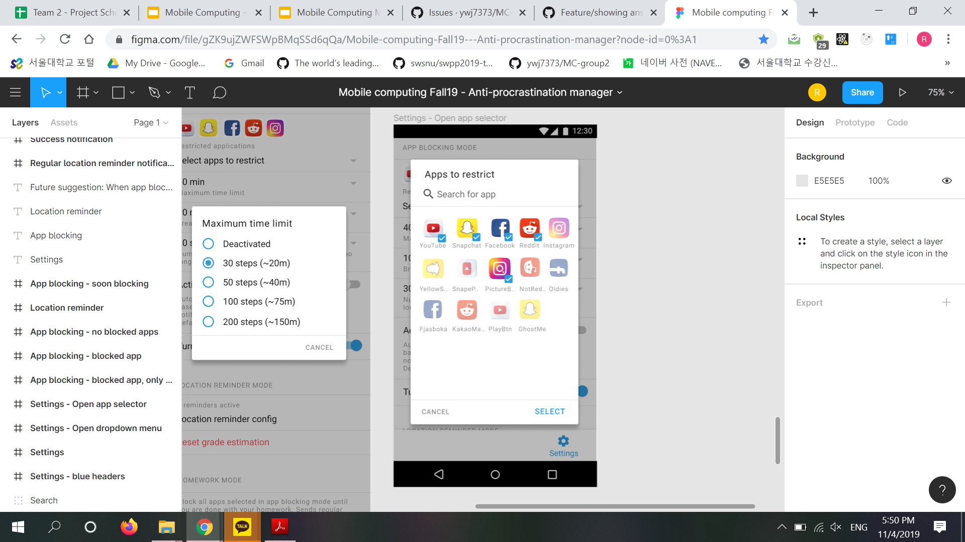
Going forward App Blocking
Things to be implemented:
Block screen for multiple apps
Notifications to inform user
Pedometer feature
Prompt users to walk a number of steps in order to unblock app
Smart blocking feature
Detects procrastination
Automatically blocks apps if you have items on todo-list (with warning)
Setting to disable feature

Slide 20
Location-Reminder Feature

Slide 21

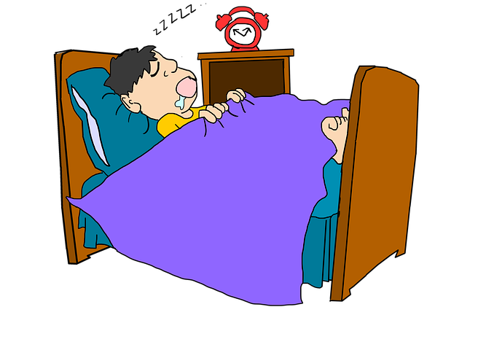



Location-Reminder Use-case
Without BlueCat
With BlueCat

Slide 22
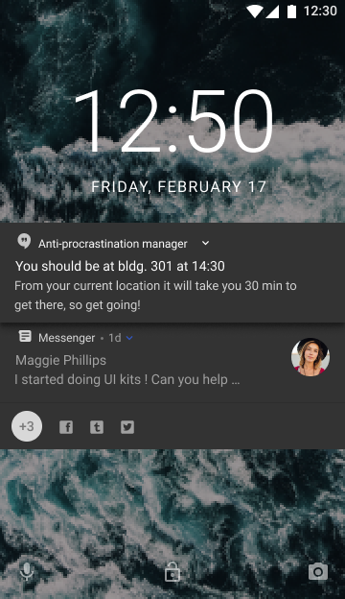
Location-Reminder Overview
The app will set off an alarm based on your schedule
It will consider your current location, and the travel time to your scheduled destination, to calculate when to set off the alarm
For example, if you take 1 hour to reach your scheduled location, the app will alert you 1 hour + alpha beforehand!!
No need to manually set an alarm every time!

Slide 23
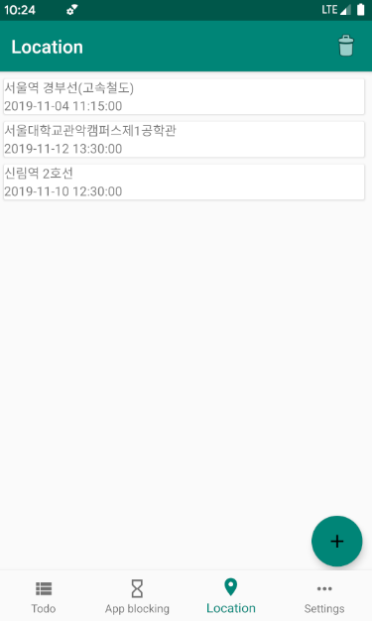
Location-Reminder Demo
Adding Item to Schedule List
Can search location ← Used Naver Map API
Select either date or days
Save and Keep schedule ← Used Room DB
Check every one minute
Call routine task every minute ← Used Receiver, Service(Foreground)
Get current position ← Used FusedLocationProviderClient
Estimate travel time ← Used ODSay API

Slide 24
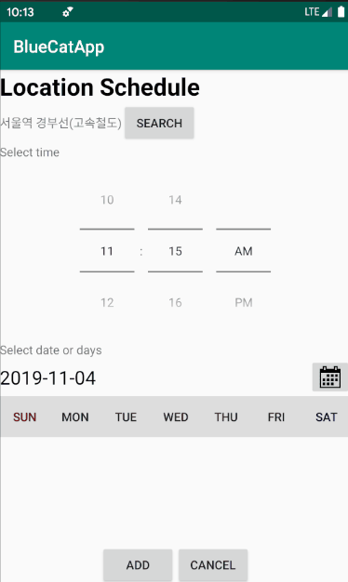
Location-Reminder Demo
Adding Item to Schedule List
Can search location ← Used Naver Map API
Select either date or days
Save and Keep schedule ← Used Room DB
Check every one minute
Call routine task every minute ← Used Receiver, Service(Foreground)
Get current position ← Used FusedLocationProviderClient
Estimate travel time ← Used ODSay API

Slide 25
Location-Reminder Demo
Adding Item to Schedule List
Can search location ← Used Naver Map API
Select either date or days
Save and Keep schedule ← Used Room DB
Check every one minute
Call routine task every minute ← Used Receiver, Service(Foreground)
Get current position ← Used FusedLocationProviderClient
Estimate travel time ← Used ODSay API
Notes:
테스트 케이스 : 초기 (신림역) -> 서울대입구역 -> 신림역 -> 구로디지털단지역

Slide 26
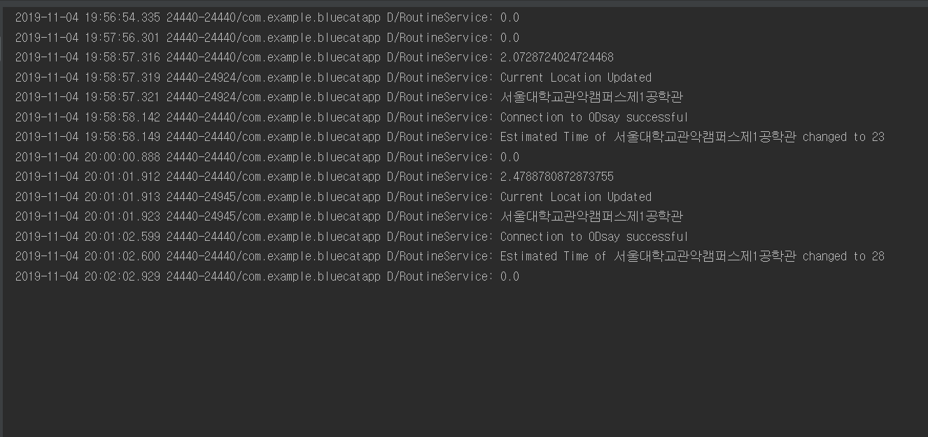
Location-Reminder Demo
Notes:
테스트 케이스 : 초기 (신림역) -> 서울대입구역 -> 신림역 -> 구로디지털단지역

Slide 27
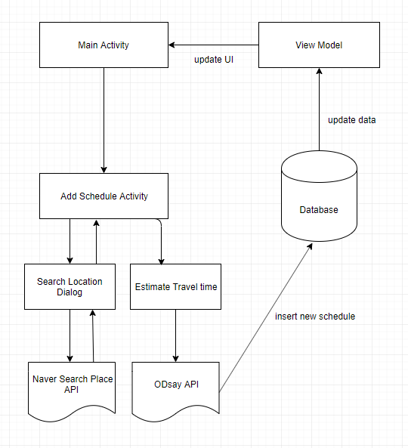
Location-Reminder Activity Architecture

Slide 28
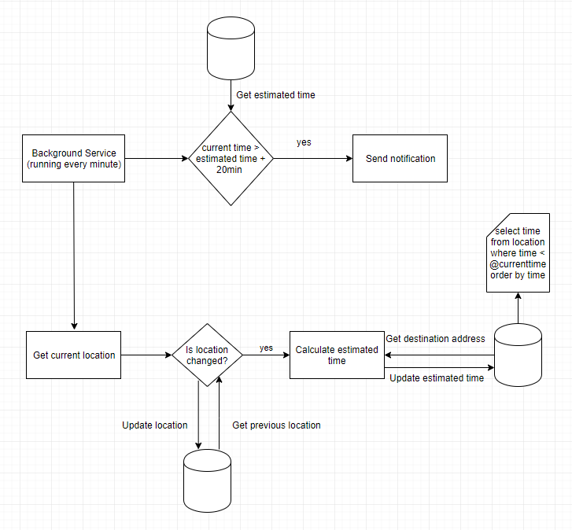
Location-Reminder Service Architecture

Slide 29
Location-Reminder Key technical challenges
Power consumption
Used FusedLocationProviderClient ← Better battery usage
Used inexact 1 minute check interval ← Synchronize with other services
Minimize redundant operation
Android prohibit background location tracking
Used ForegroundService
Used FusedLocationProviderClient
Notes:
Used FusedLocationProviderClient <- Better battery usage
Used inexact 1 minute check interval <- Android optimize check interval to synchronize with other services so it can optimize battery usage
Minimize redundant operation <- Do not estimate travel time when location did not change

Slide 30
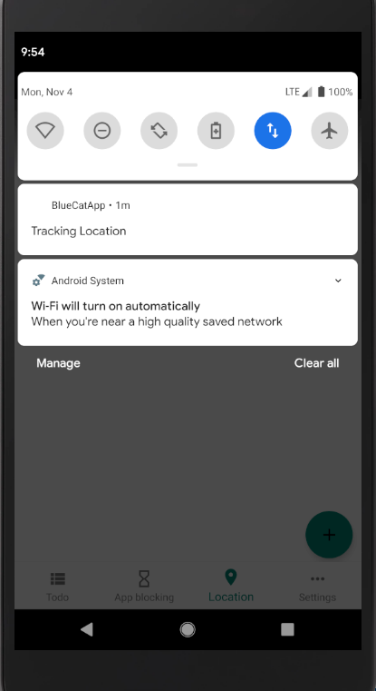
Location-Reminder Key technical challenges
Power consumption
Used FusedLocationProviderClient ← Better battery usage
Used inexact 1 minute check interval ← Synchronize with other services
Minimize redundant operation
Android prohibit background location tracking
Used ForegroundService
Used FusedLocationProviderClient
Notes:
Used FusedLocationProviderClient <- Better battery usage
Used inexact 1 minute check interval <- Android optimize check interval to synchronize with other services so it can optimize battery usage
Minimize redundant operation <- Do not estimate travel time when location did not change

Slide 31
Going forward Location-Reminder
Not yet implemented
Gamification
Alarm or Notification*
Multiple test cases
Various settings (turn on/off, duration, result in english?)
Things to improve
UI
Better ways to decrease power consumption

Slide 32
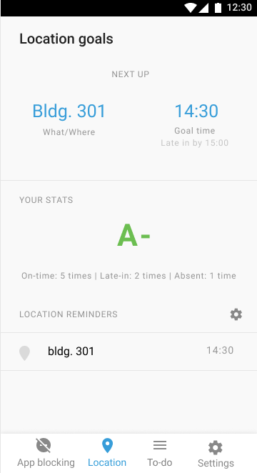
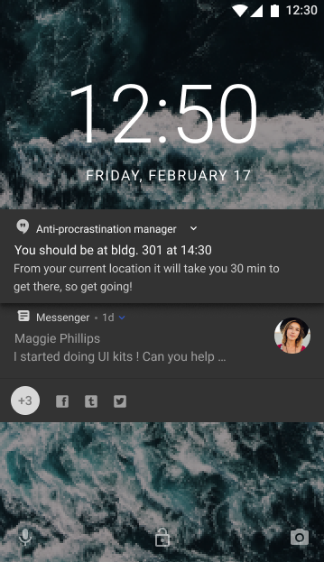
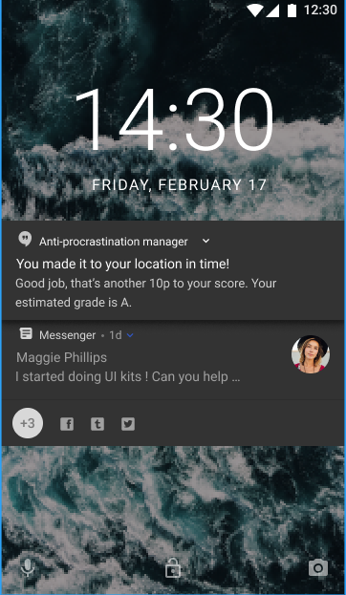
Location-Reminder Final Product

Slide 33
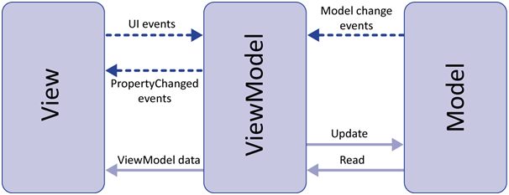
Key Takeaways from first part of project
Intro to Android Programming with Kotlin
Android MVVM pattern
Usage of different APIs
Implementation of foreground services to keep app functionality alive
There is a lot of restrictions and APIs in Android that makes developing challenging!

Slide 34

Final Deliverable & Success Criteria
Todo List & Homework Mode
Stable homework mode that keeps track of time while the mode is on.
Send notification and fire the alarm at proper time.
Accurate detection of user motions ( shaking and walking )
App Blocking
Successfully block selected apps based on settings configuration
Unblock app after step count completed and/or timer completed
Location-Reminder
Stable location tracking and travel time estimation
Send notification and fire the alarm at proper time.
Reward and penalize properly in gamification
Notes:
How does your final solution look like?
How do we judge the success of the project? (at least we should have the planned functionality, the UI can differ a little)

